Slide 1


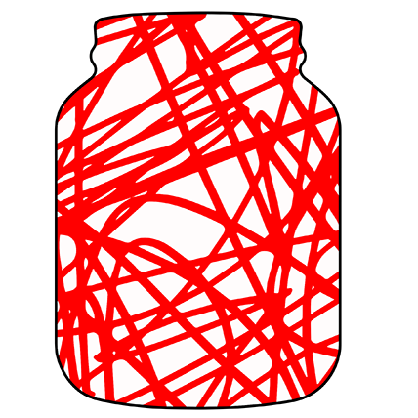

code.
jam()
proudly
presented by

